Slide 1

Model Selection (and Validation)
Part I - Metrics
Rayid Ghani and Kit Rodolfa

Slide 2
Group Updates
Collaborative Document for Questions/Feedback: https://bit.ly/ml4pp-updates
Today’s Update:
Modeling Formulation Worksheet
Row, label, feature(s), train-test set(s), model(s), metric(s)
Plan for This Week

Slide 3
Evaluation - Methodology
In-sample
Out of sample
Multiple Out-of-sample (Hold-out) Splits
Cross Validation
Leave one out (LOO)
K fold
Temporal Holdouts

Slide 4
Score Distribution on the Test Set
# of people
Score

Slide 5
Evaluation - Metrics
Predictions are often scores between 0 and 1
We need to first turn them into 0 or 1 by selecting a threshold
Predicted Class
 | Yes | No
Yes | True Positives (TP) | False Negatives (FN)
No | False Positives (FP) | True Negatives (TN)
Actual Class

Slide 6
Evaluation – Metrics (at a threshold k)
Accuracy = (TP + TN) / (TP + TN + FP + FN)
Precision (or PPV) = TP / (TP + FP)
Recall (or Sensitivity) = TP / (TP + FN)
Specificity = TNR
Predicted
 | Yes | No
Yes | True Positives (TP) | False Negatives (FN)
No | False Positives (FP) | True Negatives (TN)
Actual

Slide 7
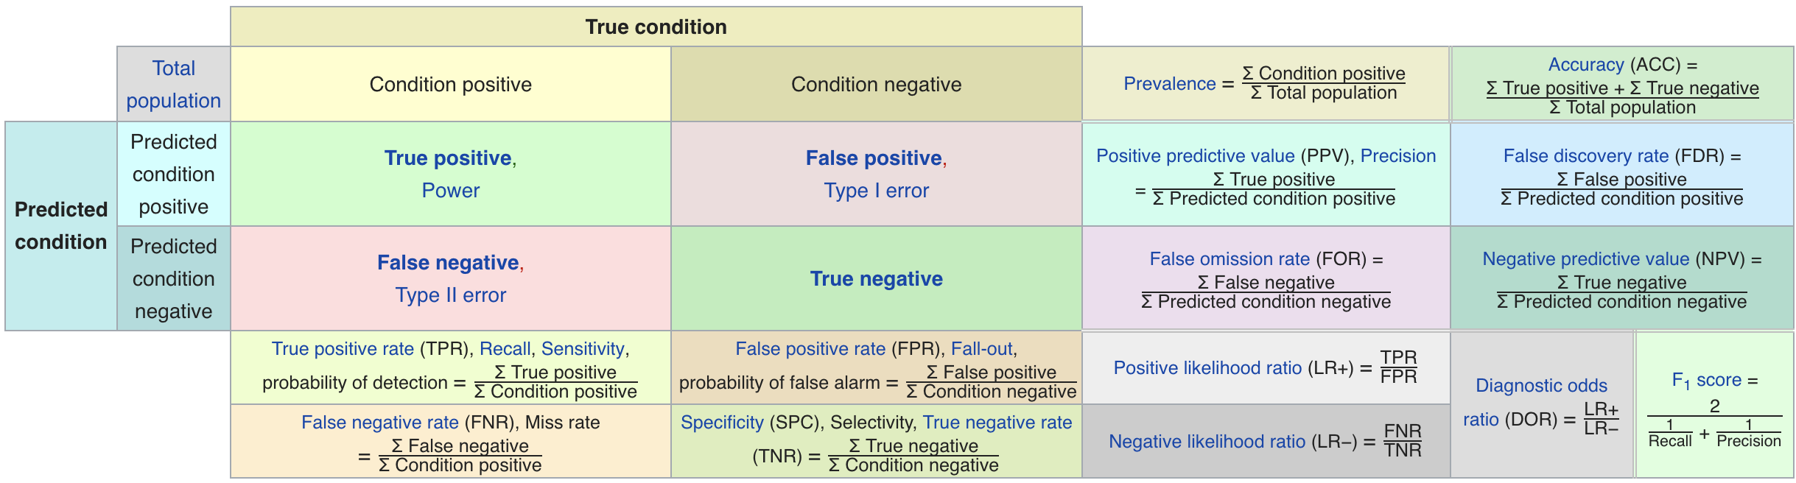
Metric Cheatsheet
Source: https://en.wikipedia.org/wiki/Sensitivity_and_specificity

Slide 8
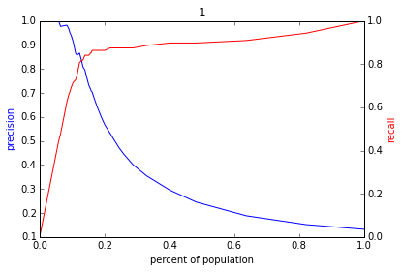
Varying the Threshold
Score
1 .9 .8 .7 .6 .5 .4 .3. .2 .1
| | | | | | | | | |
Baseline

Slide 9
ROC Curve
Receiver Operator Characteristic Curve

Slide 10
AUC (Area Under Curve)
Overall measure of performance
1 if all 1s are ranked above all 0s
0 if all 0s are above all 1s

Slide 11
Evaluation - Baselines
Random (predict most frequent class)
Simple heuristics
Expert heuristics (what may be in use today)

Slide 13
AUC – Area Under Curve
If you care about the entire space

Slide 14
Things to remember
Due Thursday: code for v0 of pipeline
Thursday Deep Dives: O1 and D1

